Slide 1


AtliQ Hardware
INSIGHTS FROM AD HOC REQUESTS

Slide 2

Content
Company overview
Problem statement
Dataset and model
Ad-hoc requests, output and insights
Recommendations

Slide 3

Company Overview
AtliQ manufactures and sales hardware.
To customers like Croma, Best Buy, Flipkart, Amazon etc.
Manufacture → Warehouse → Distribution Centres → Customers → Consumers
Customers are Brick and mortar and Ecommerce types
Retailers, Distributors and Direct sales are channels

Slide 4

Problem Statement
To answer and generate reports for Ad Hoc requests given by Product owner

Slide 5
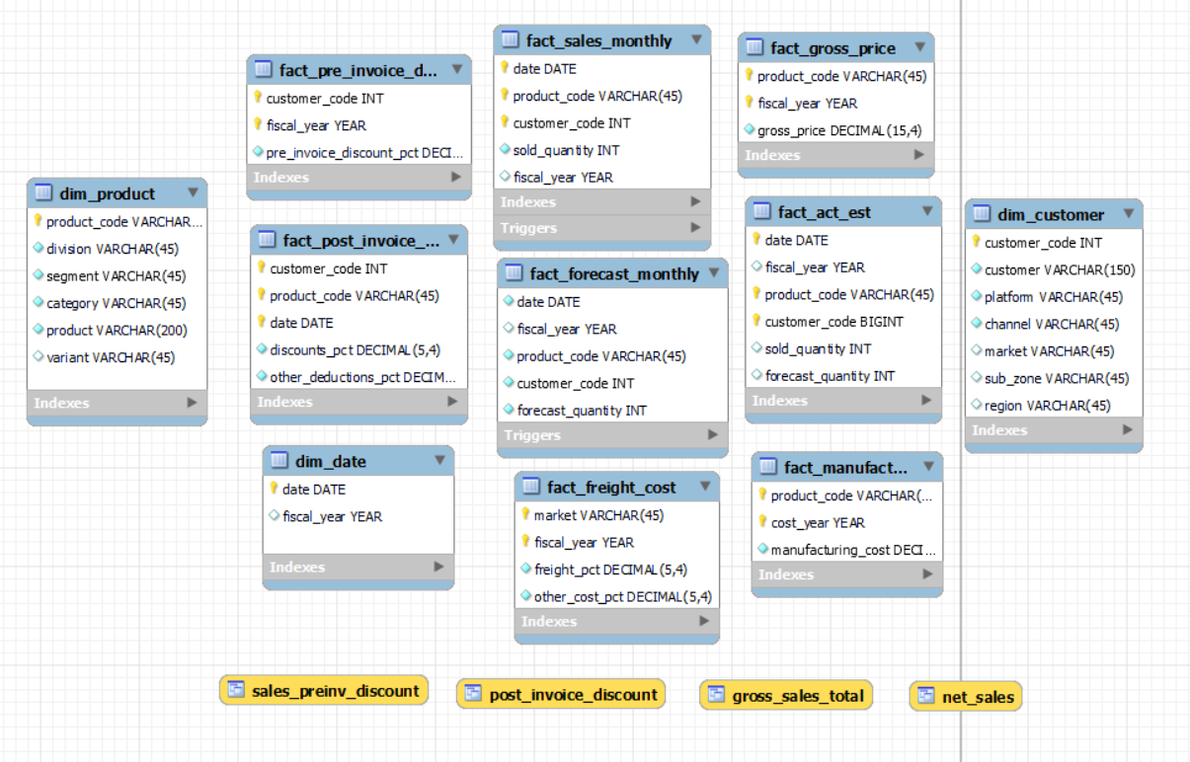
Dataset and model

Slide 6
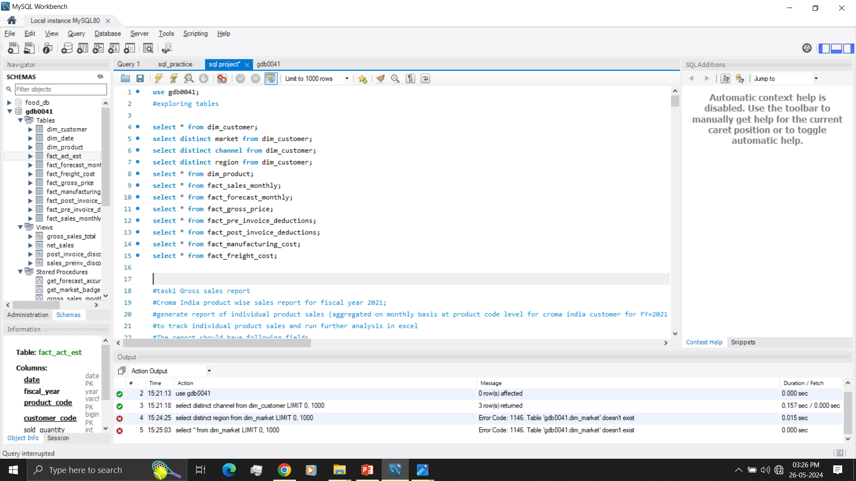
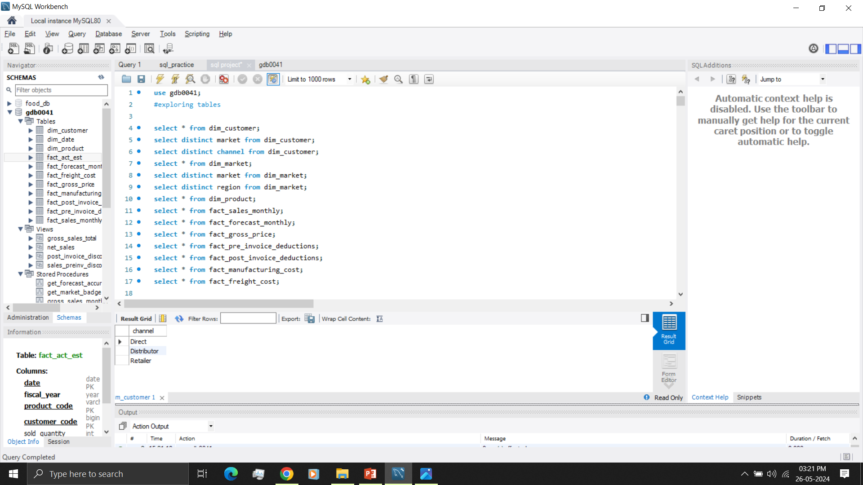

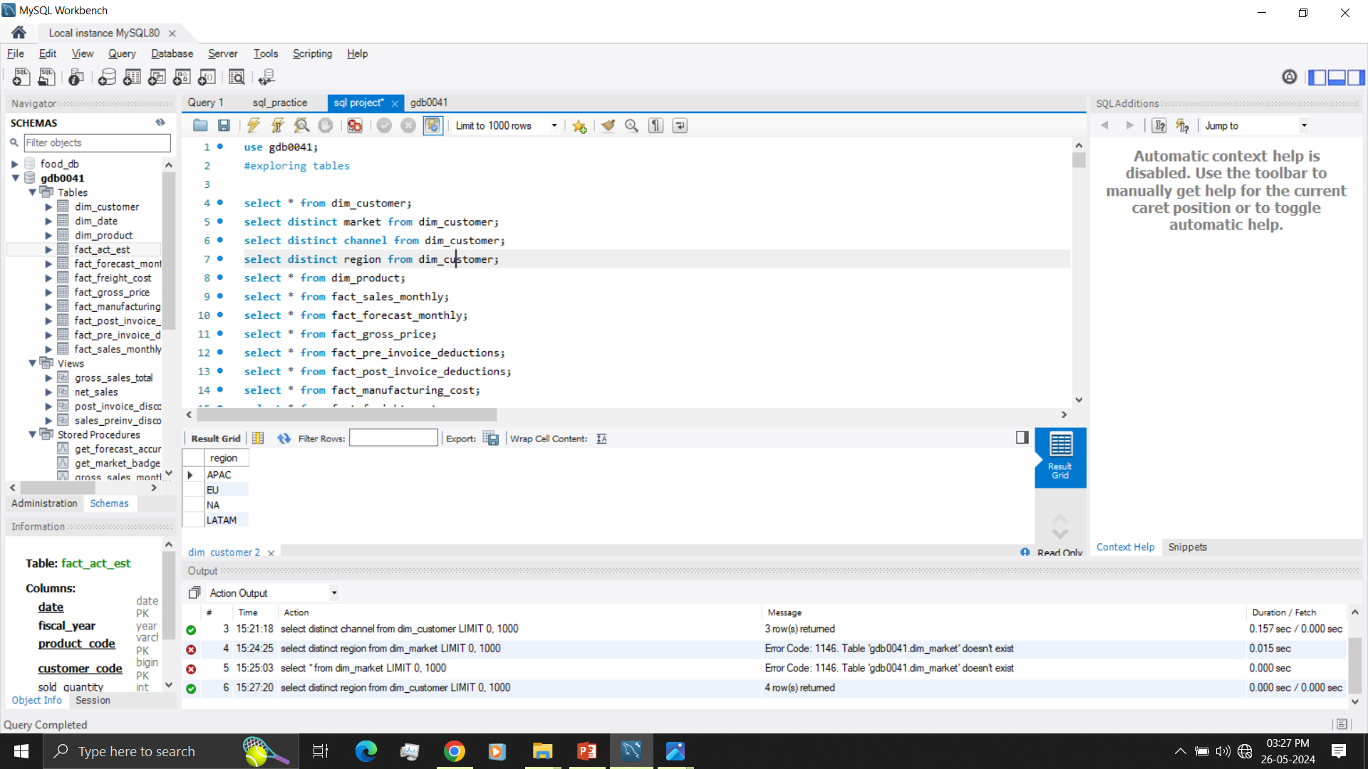
Exploring Data

Slide 7
Ad-hoc requests, output and insights
1. Gross sales report
Product wise sales report for the customer Croma India for fiscal year 2021
Details: Generate report of individual product sales (aggregated on monthly basis at product code level for Croma India customer for FY=2021 to track individual product sales and run further analysis in excel. The report should have following fields
-- Month
-- Product name
-- Variant
-- Sold quantity
-- Gross price per item
-- Gross price total

Slide 8
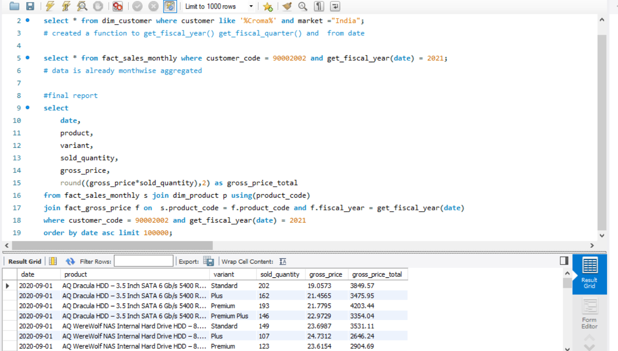


Slide 9
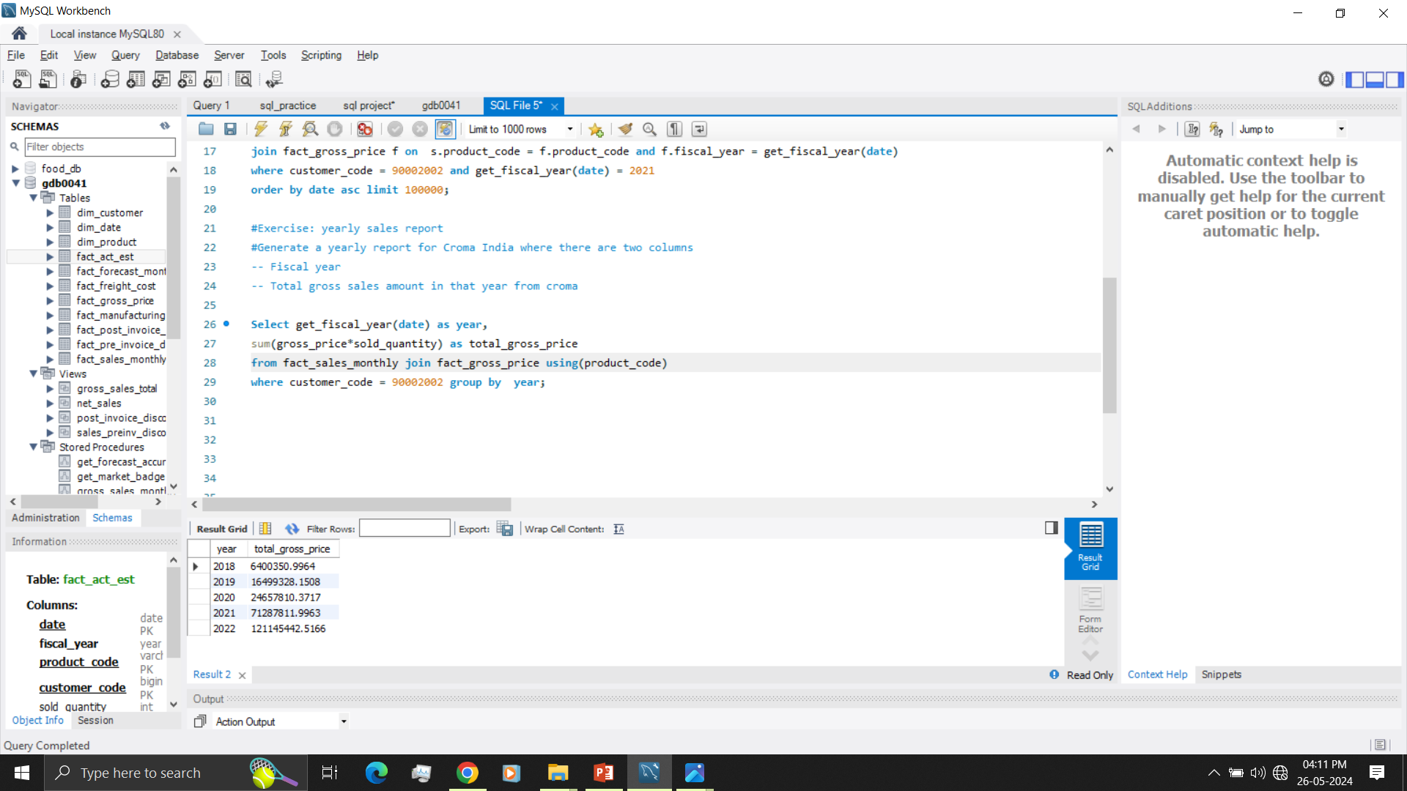
2. Yearly sales report
Generate a yearly report for Croma India with columns
-- Fiscal year
-- Total gross sales amount in that year from Croma

Slide 10
3. Market Badge
Create a stored procedure that can determine the market badge based on the following logic
-- If total sales quantity > 5 million that market is considered as gold else it is silver
-- Input market and fiscal year
-- Output badge
-- To know where AtiliQ’s prominent sales are happening

Slide 11
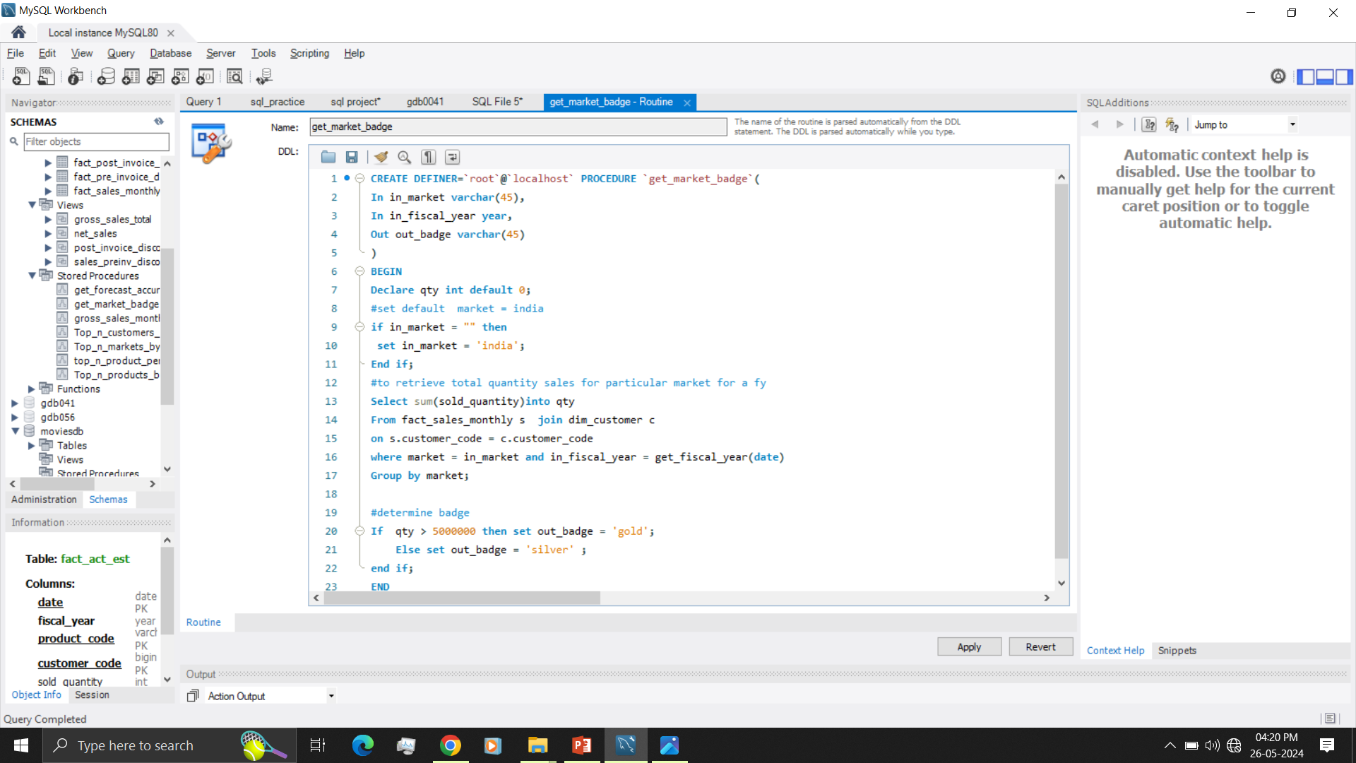
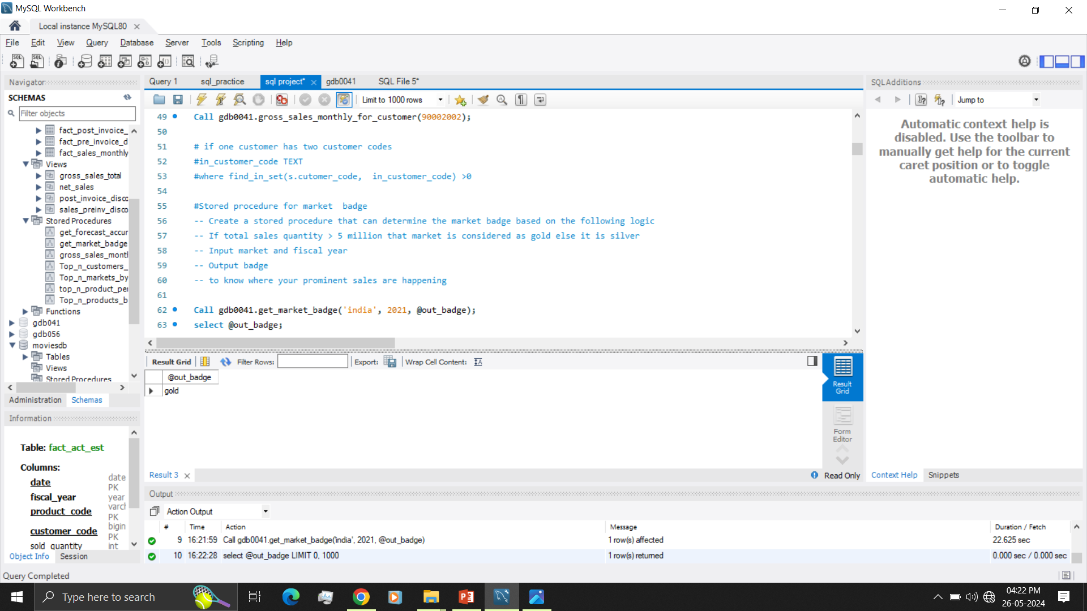

Slide 12
4. Top Markets, Customers, Products based on Net Sales
Net pre invoice sales = Gross sales – Pre invoice deduction
Net sales = Net pre invoice sales – Post invoice deduction

Slide 13
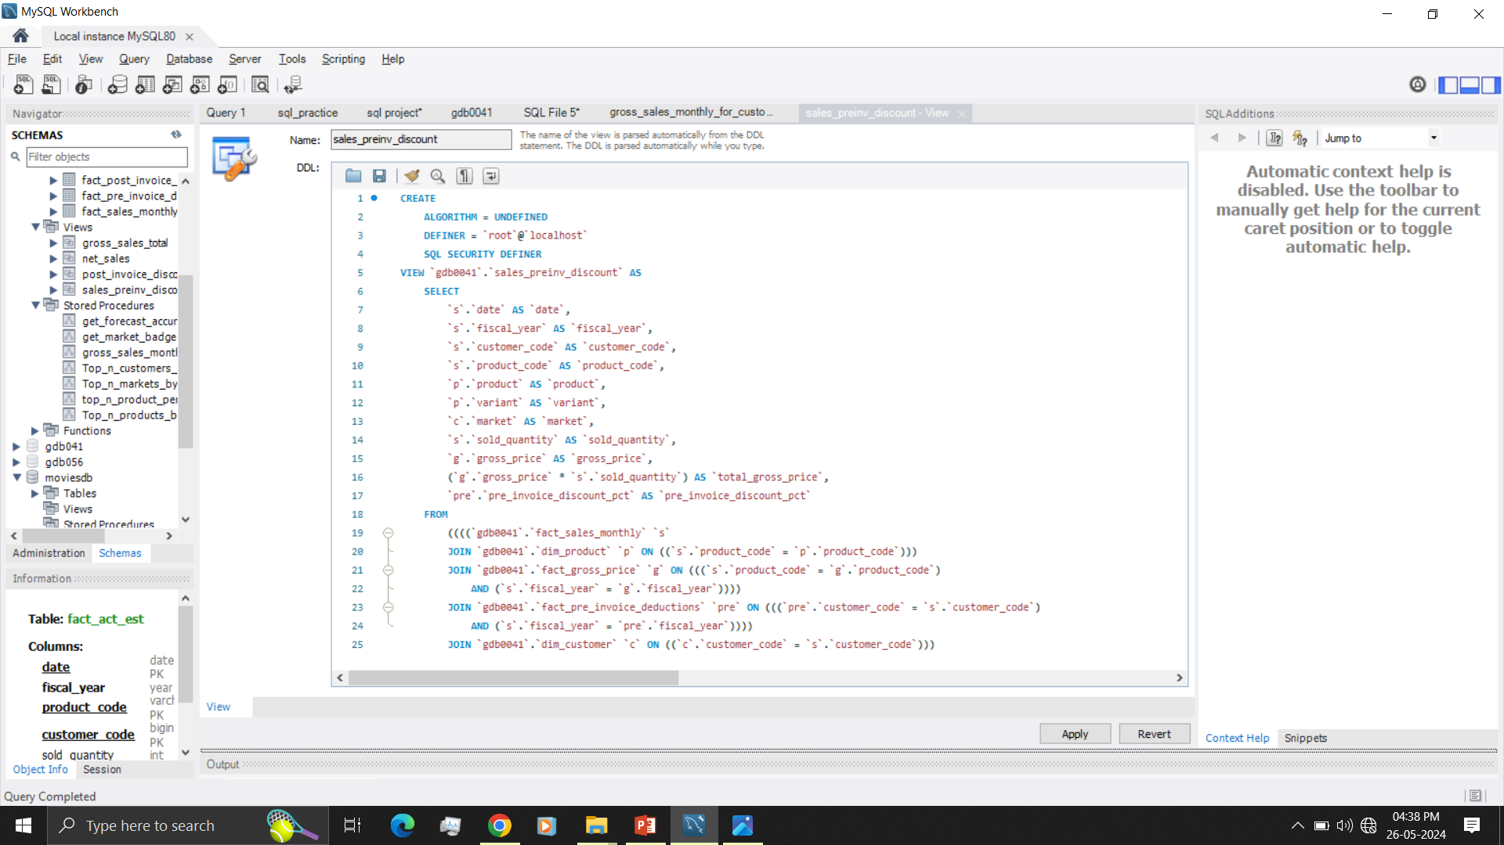
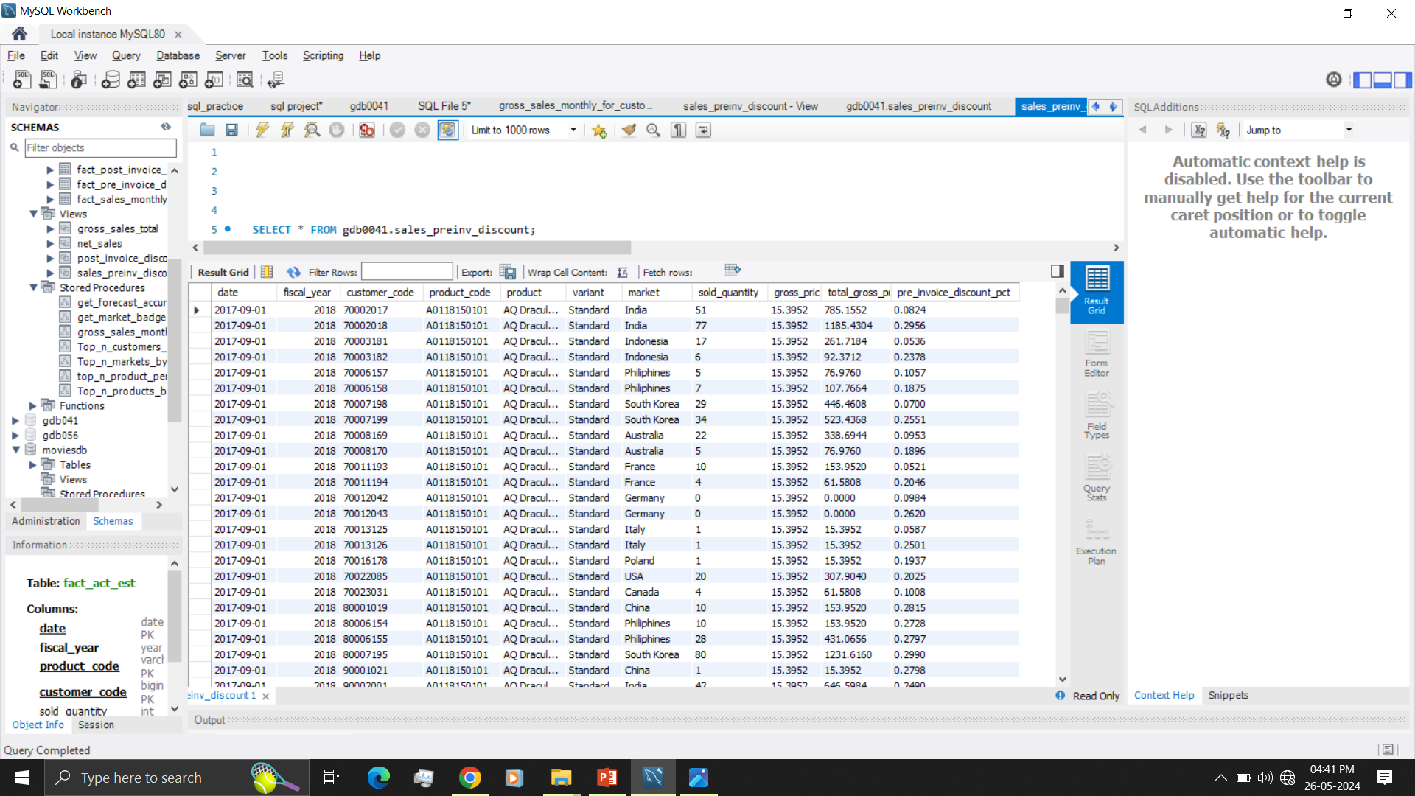
Created view for pre invoice discount

Slide 14
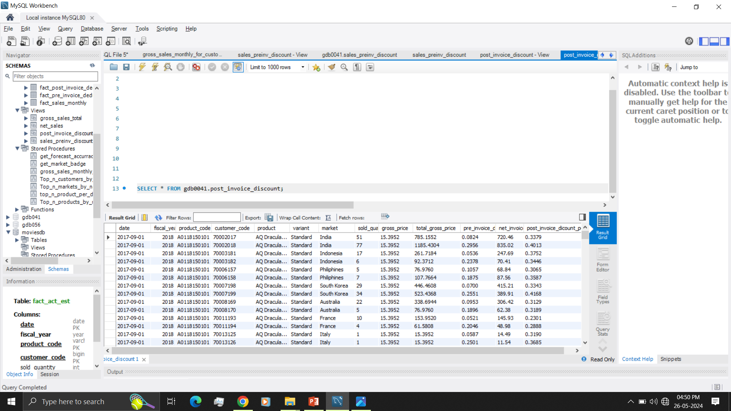
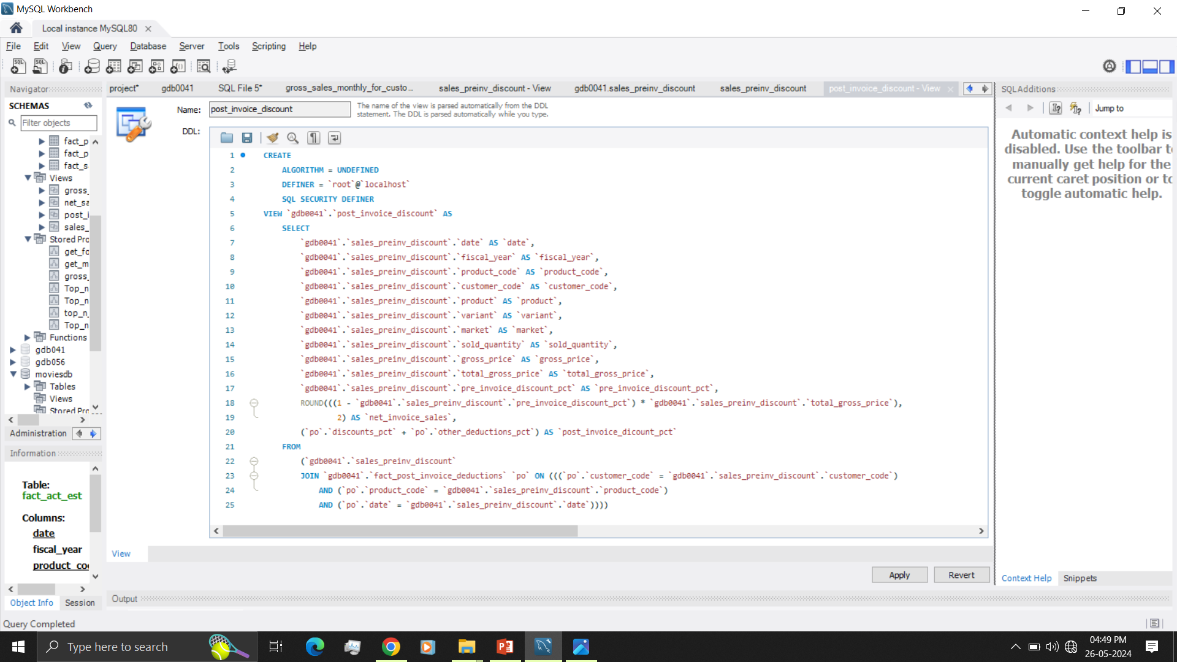
Created view for post invoice discount

Slide 15
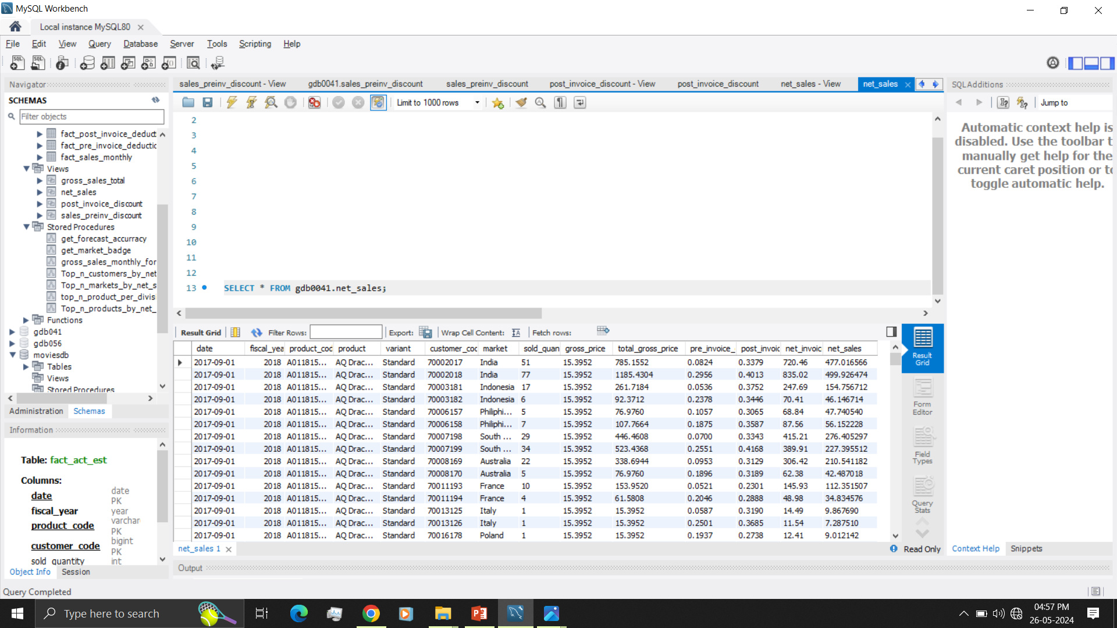
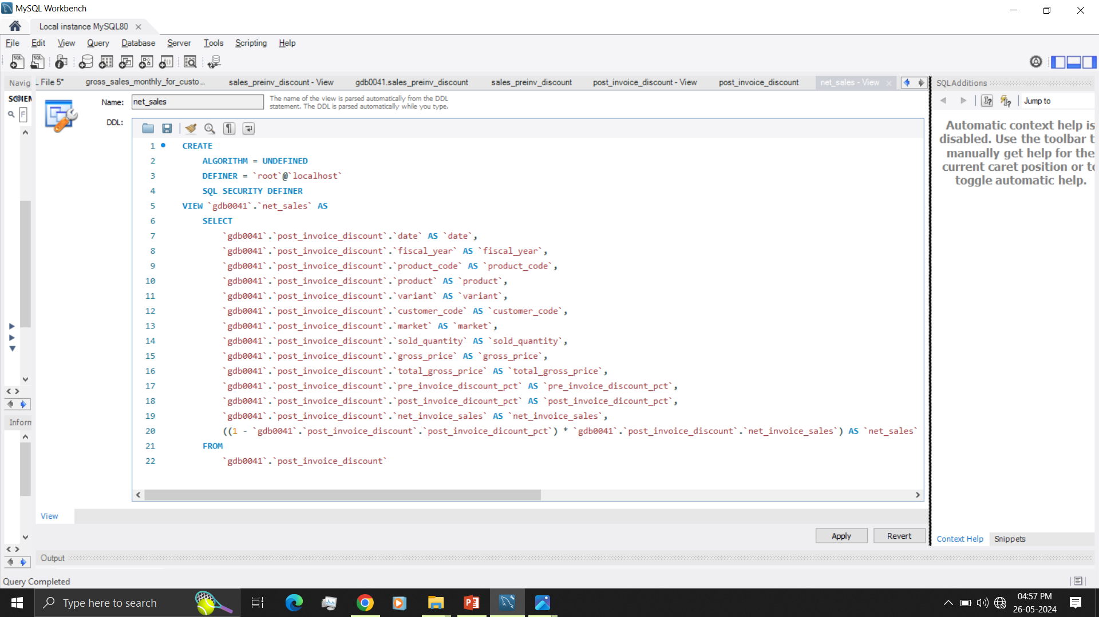
Created view for net sales

Slide 16
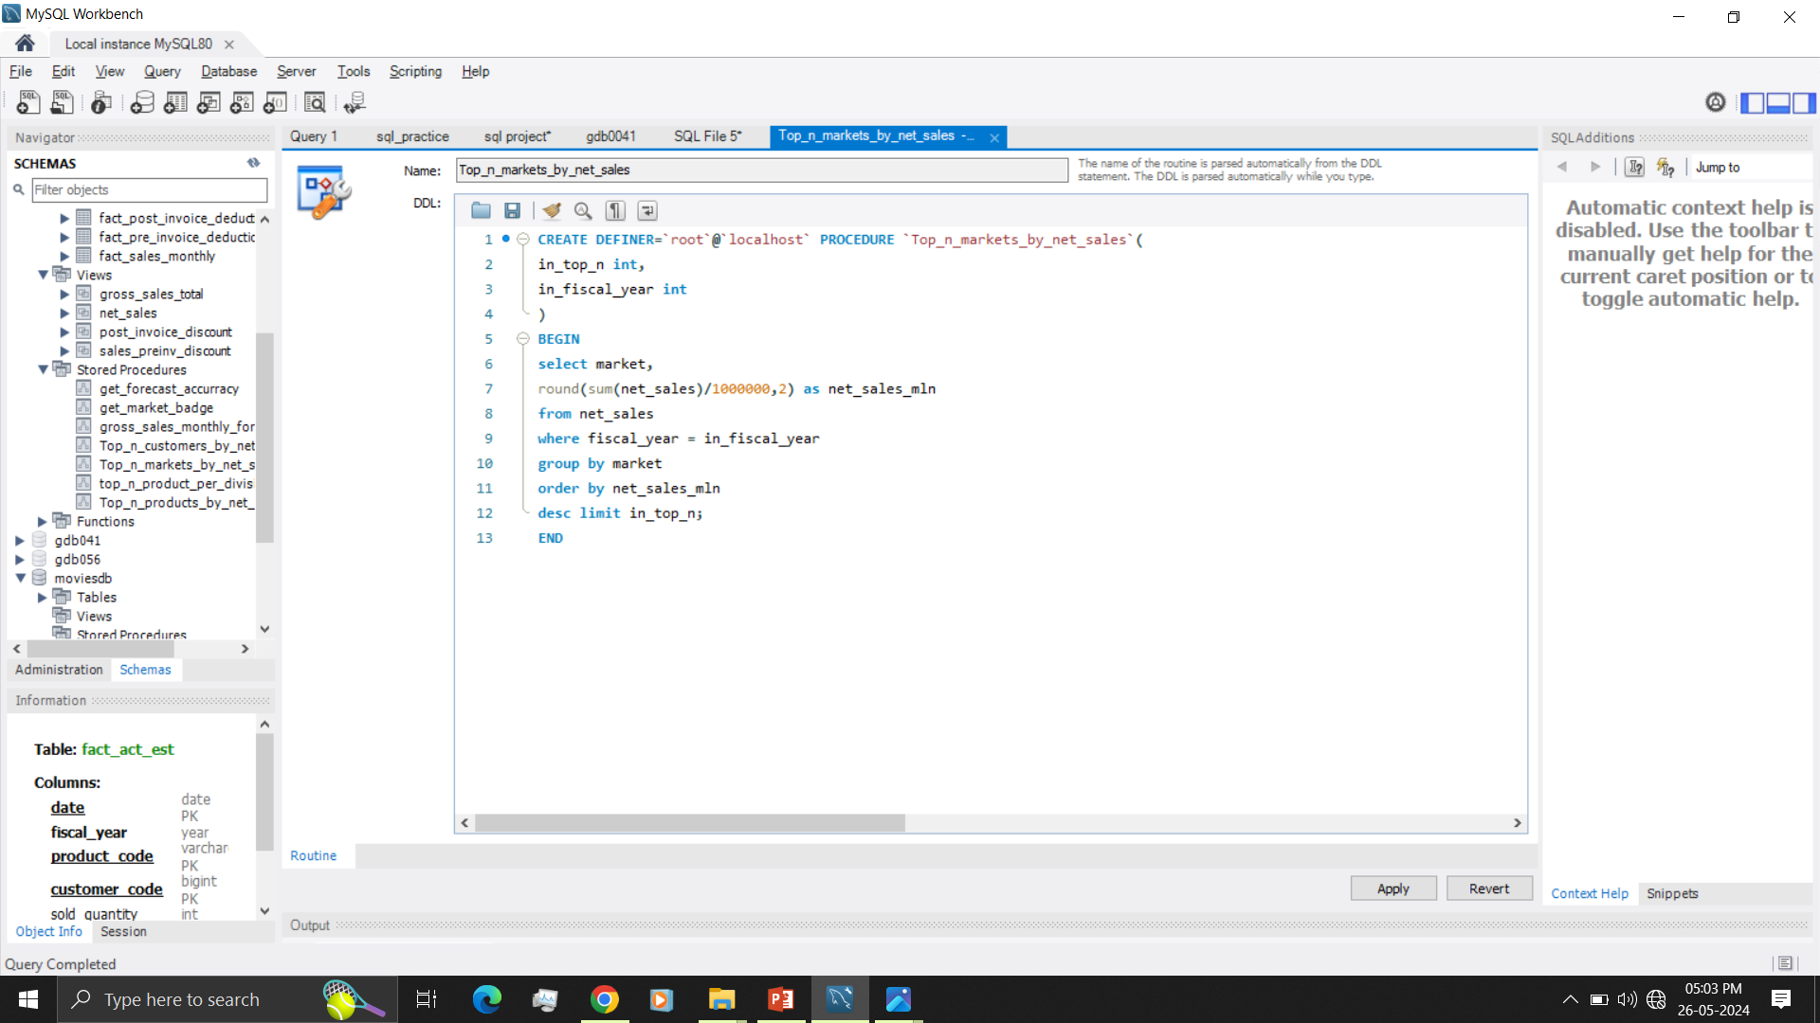
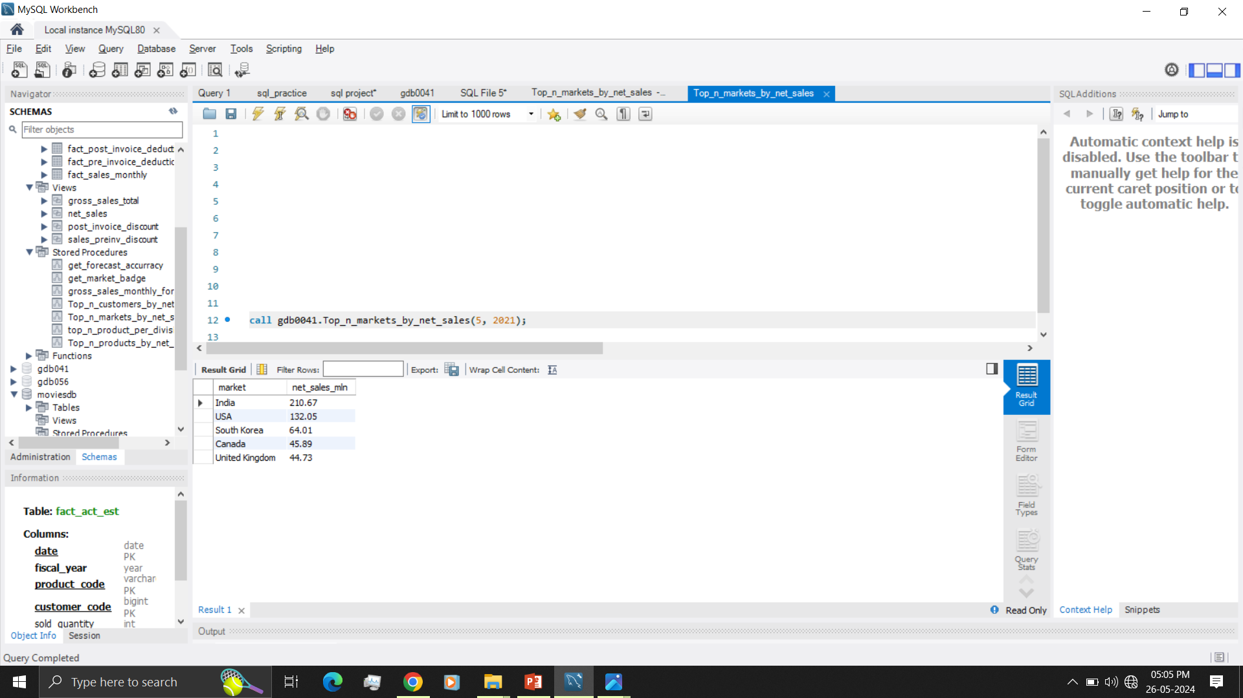
Top markets by net sales

Slide 17
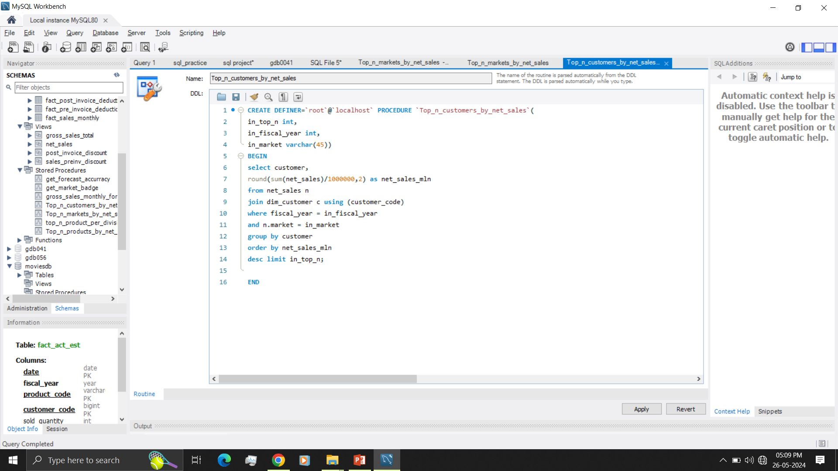
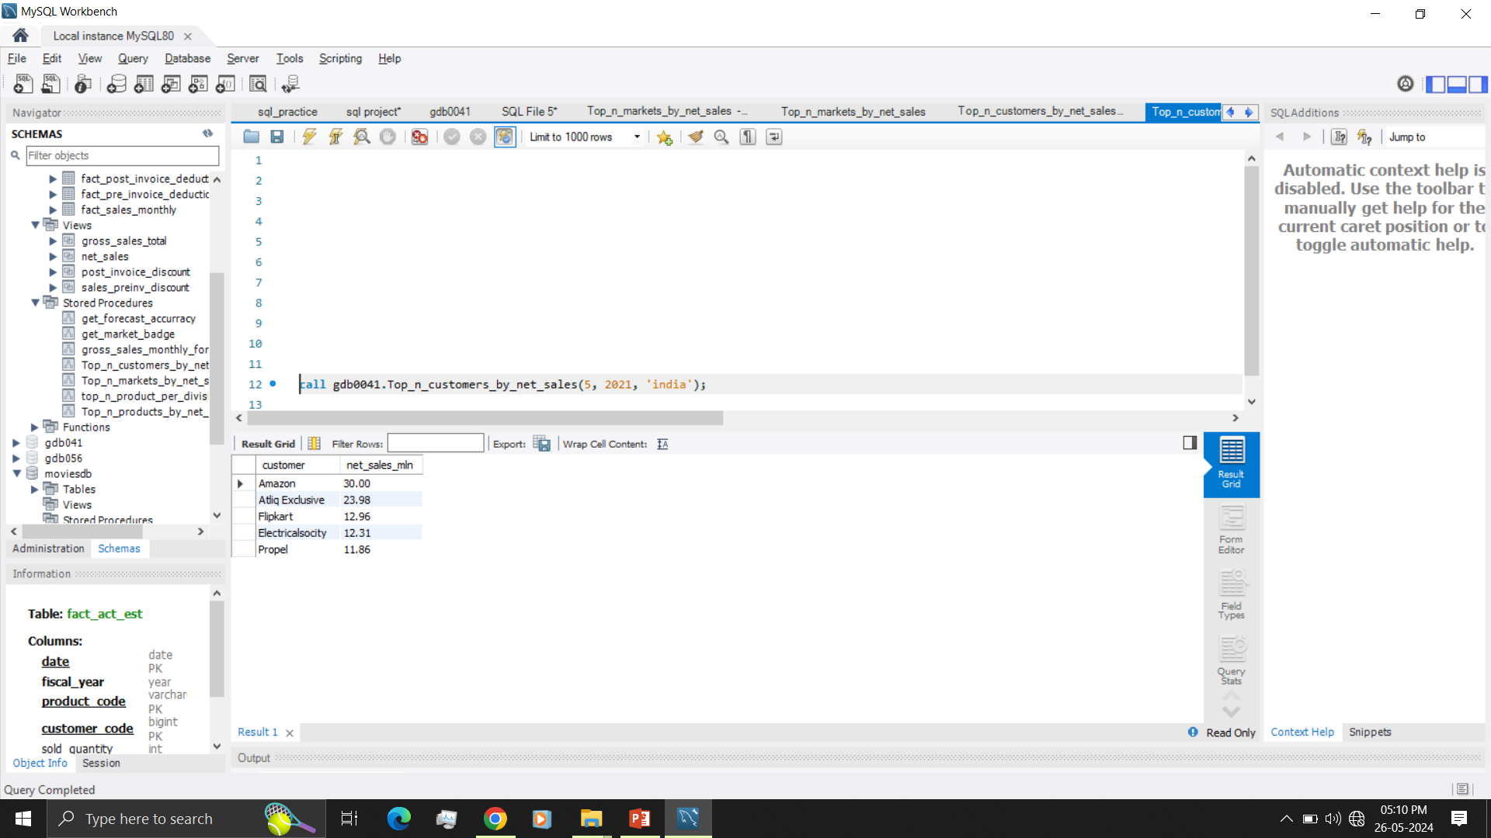
Top customers by net sales

Slide 18
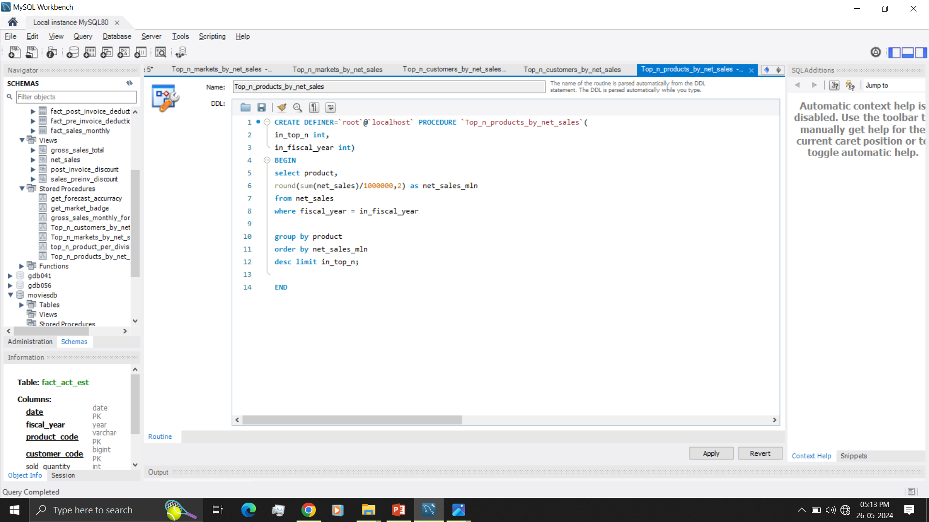
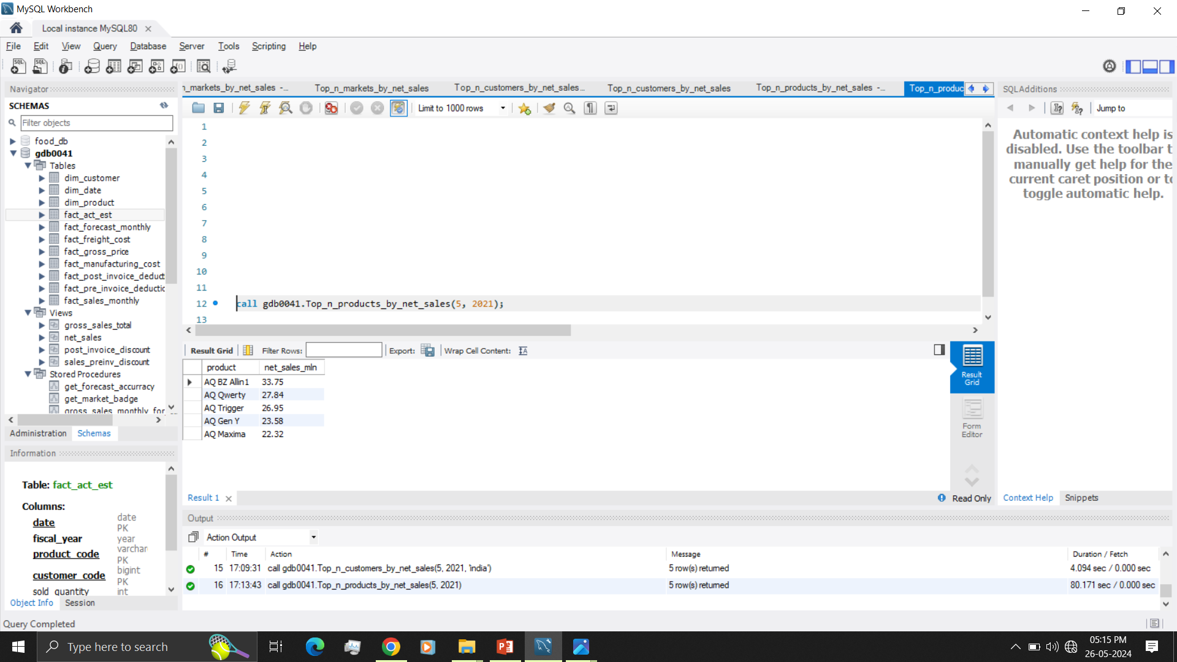
Top products by net sales

Slide 19
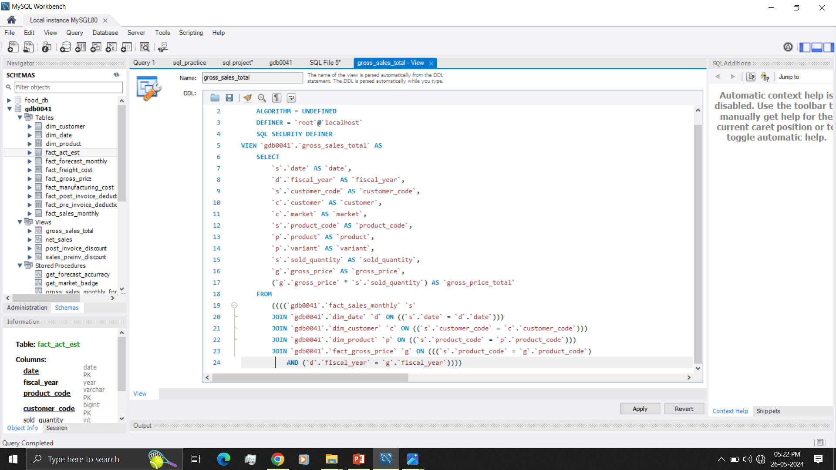
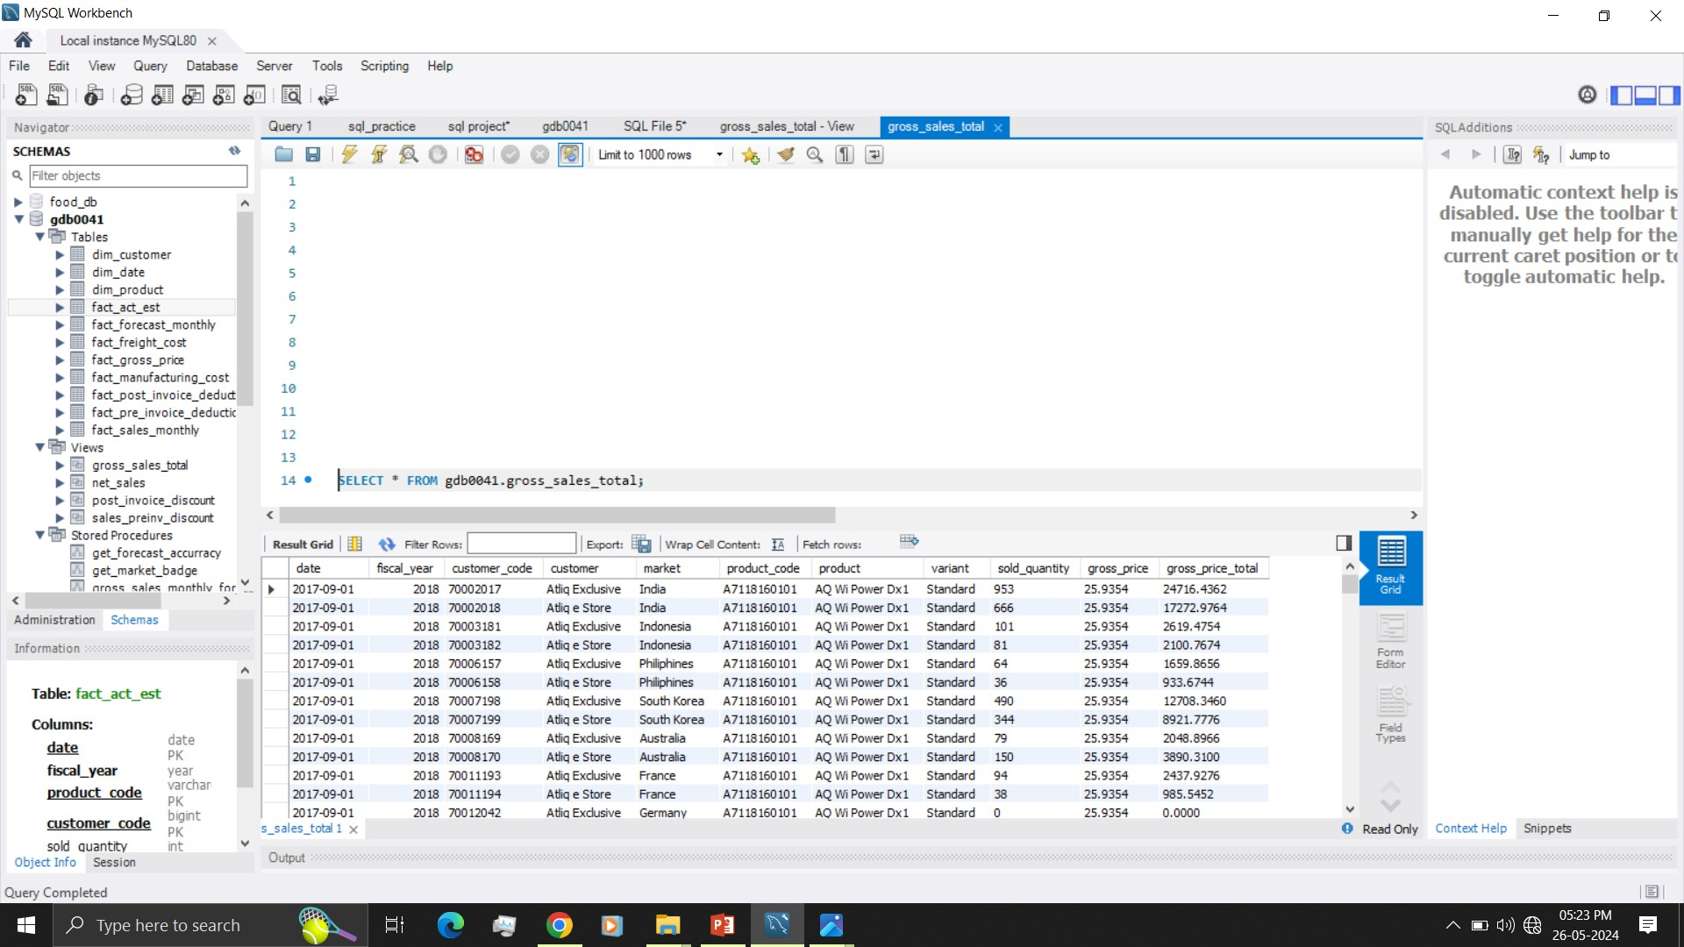
5. Gross sales view
With following columns
-- date
-- fiscal_year
-- customer_code
-- customer
-- market
-- product_code
-- product
-- variant
-- sold_quantity
-- gross_price_per_item
-- gross_price_total

Slide 20
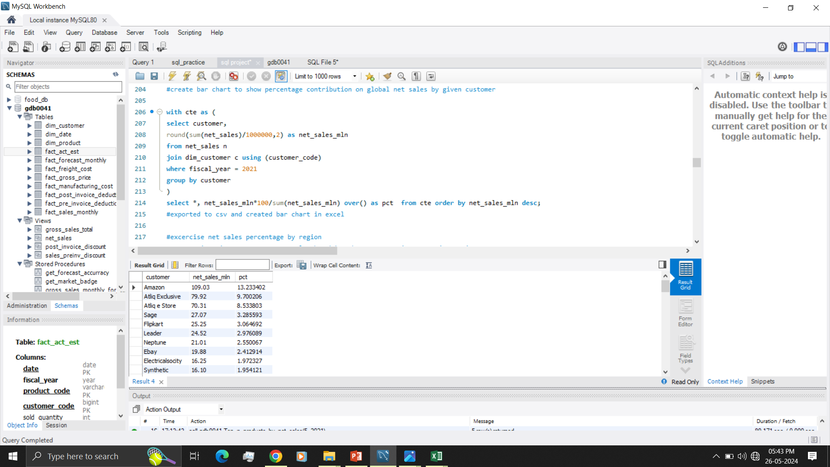
6. Percentage contribution on global net sales by given customer

Slide 21
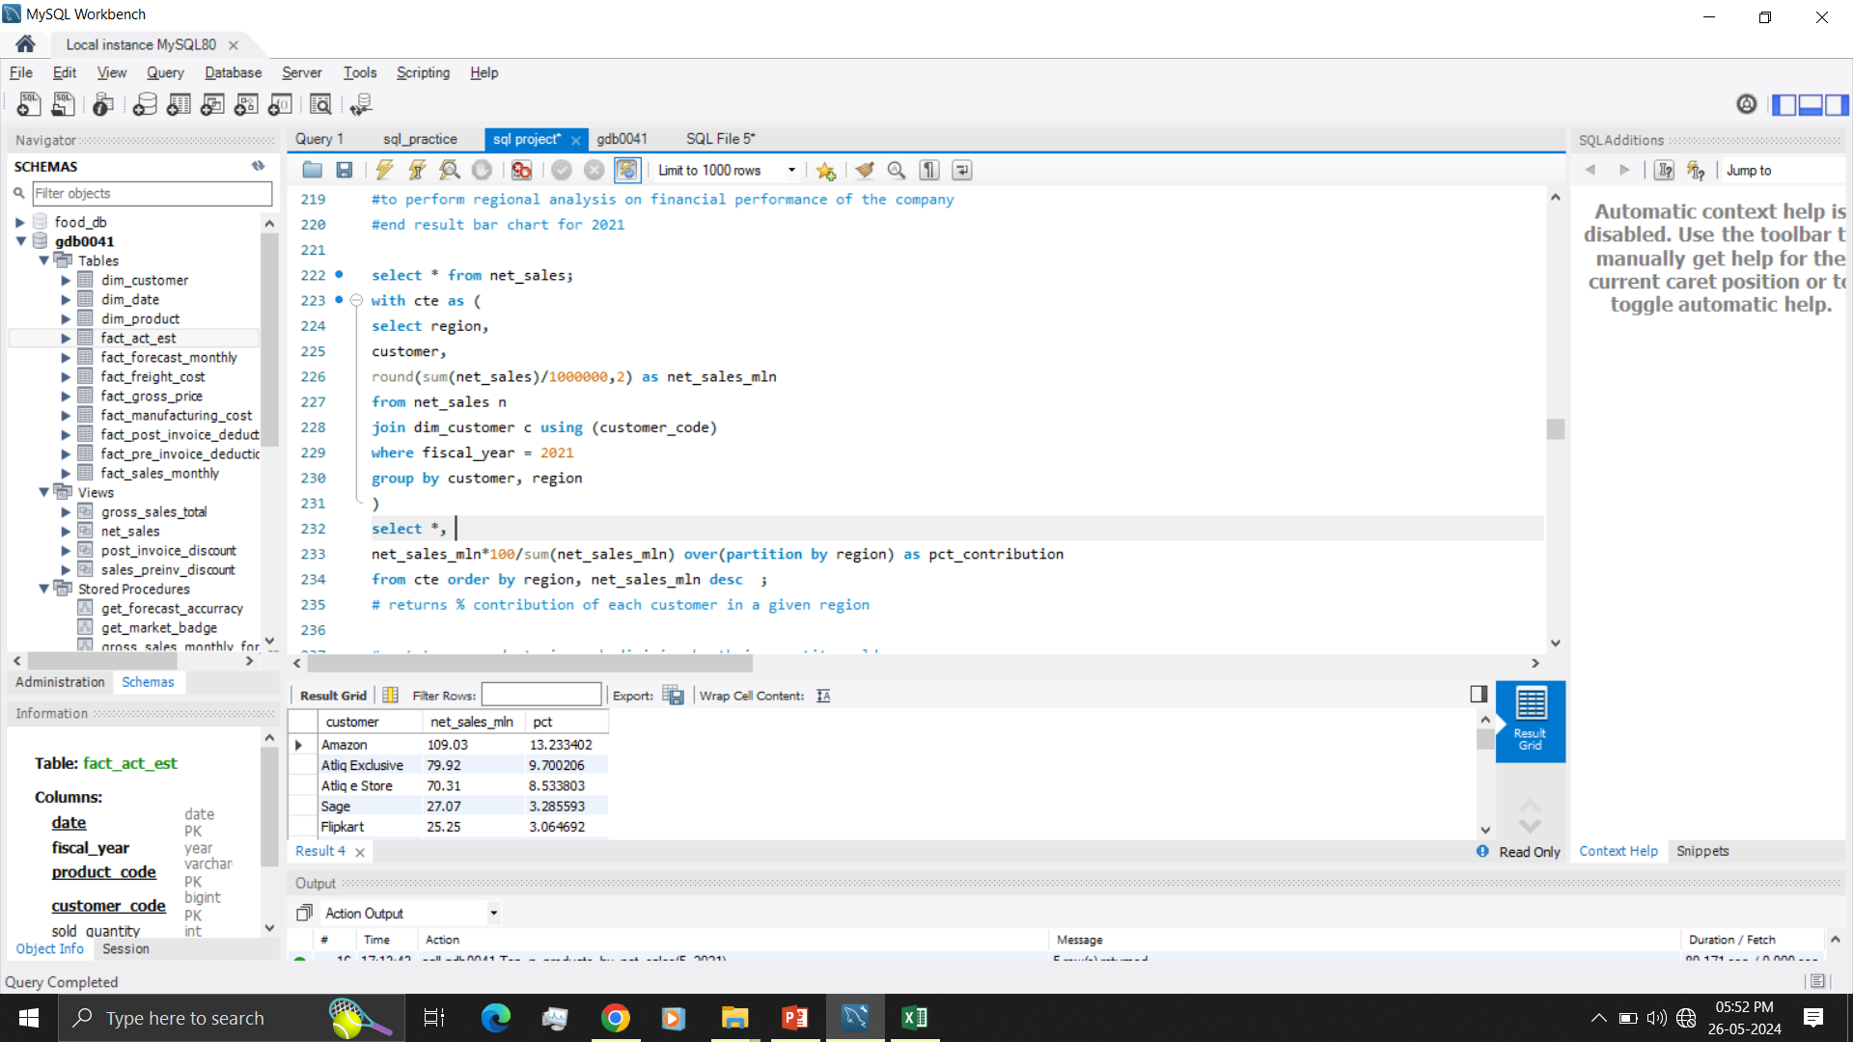
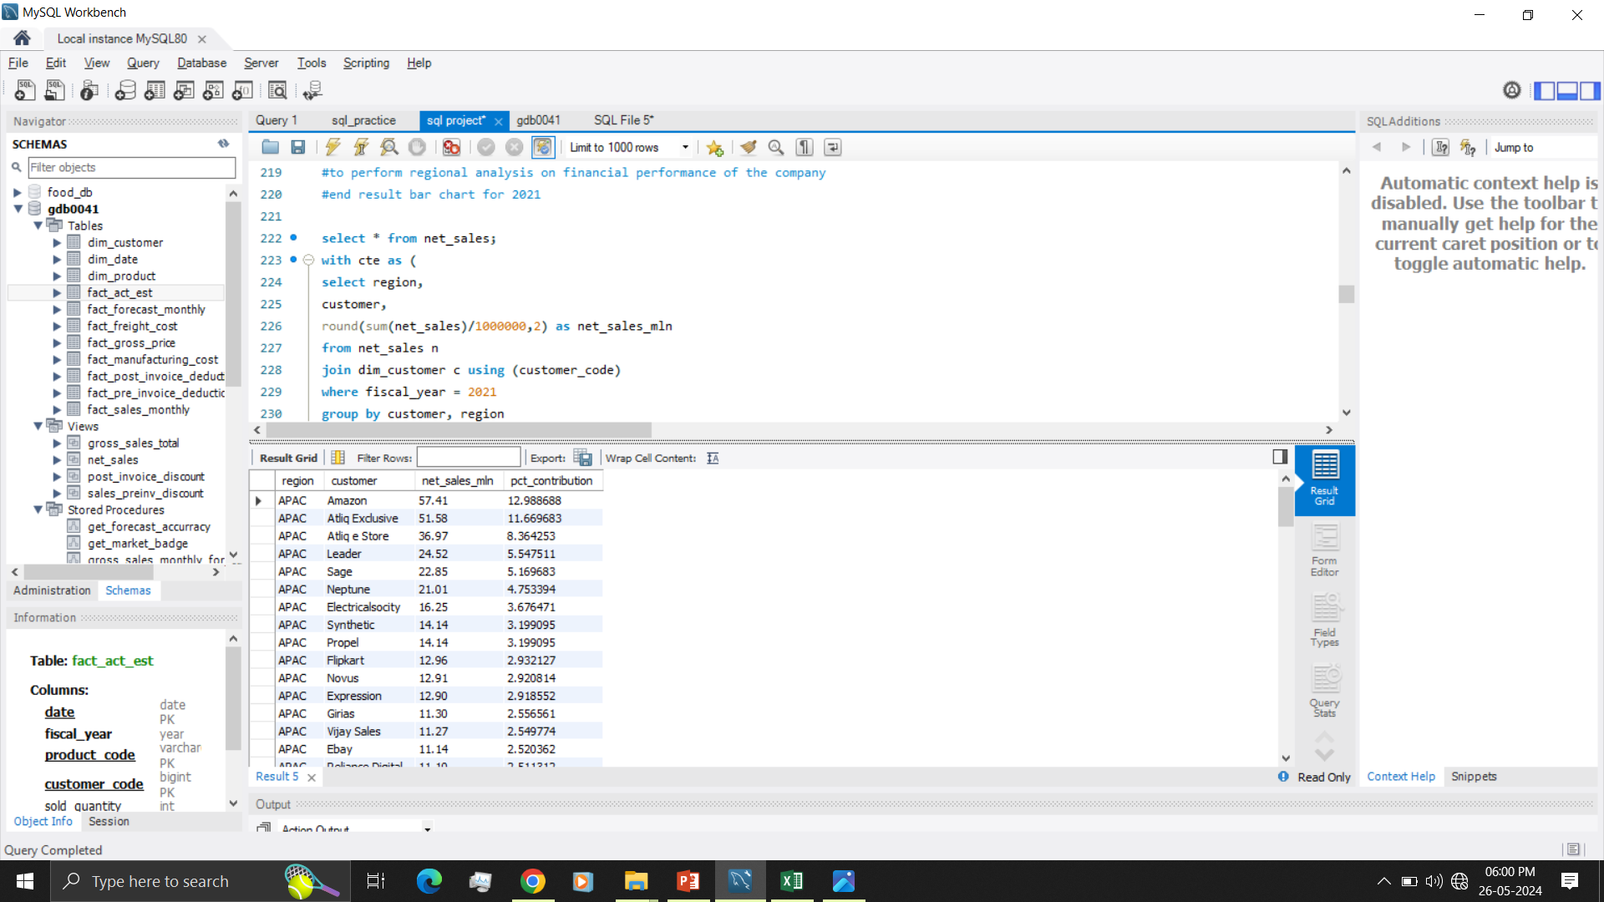
7. Percentage contribution on region wise net sales by given customer
Region wise percentage net sales breakdown by customers to perform regional analysis on financial performance of the company for 2021

Slide 23
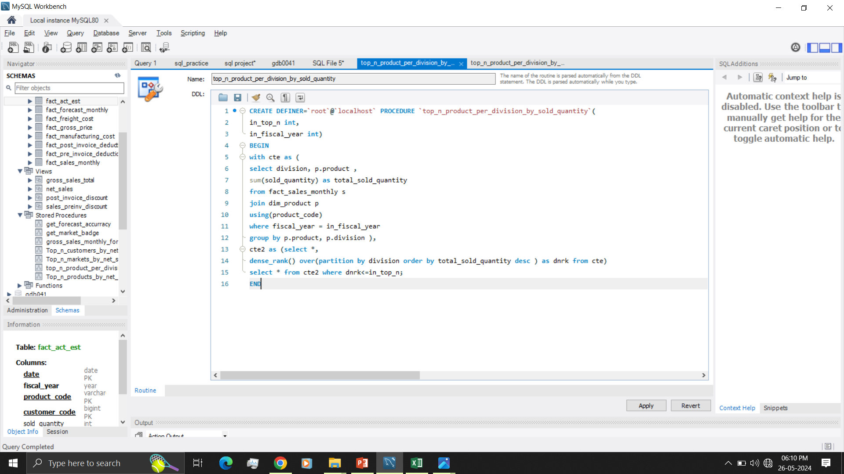
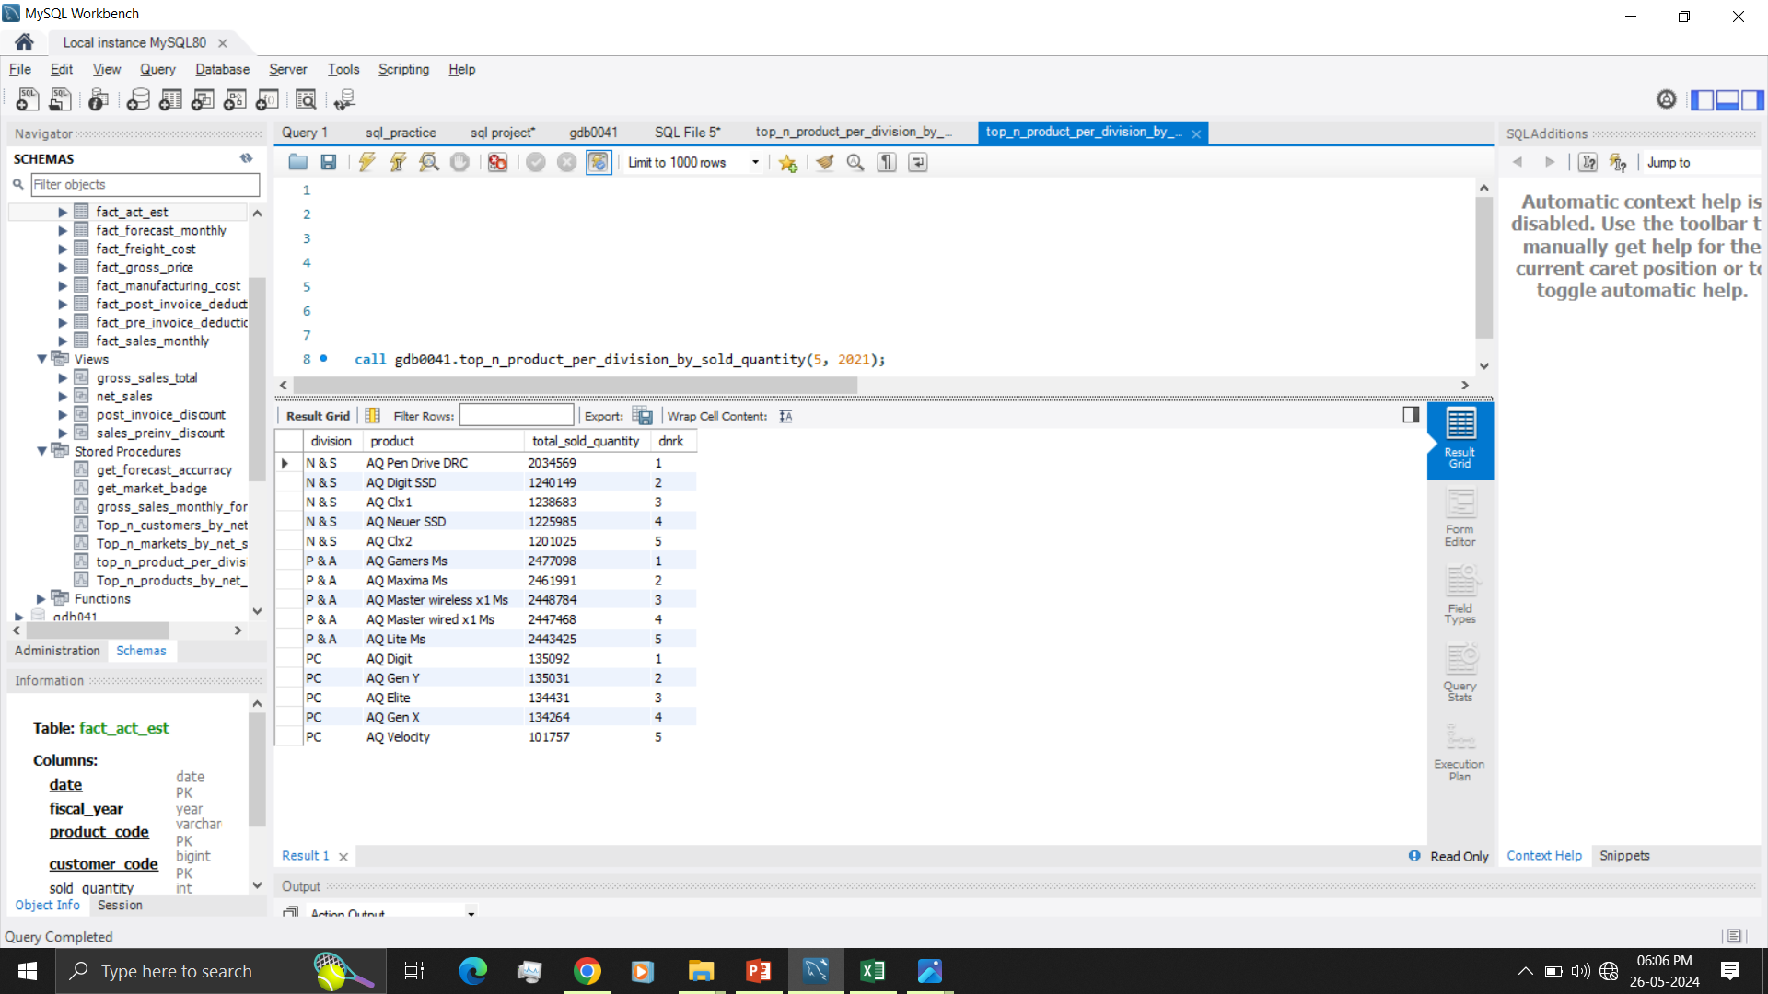
8. Top n products in each division by their quantity sold
Details: create stored procedure for getting top n product in each division by their quantity sold in a given financial year

Slide 24
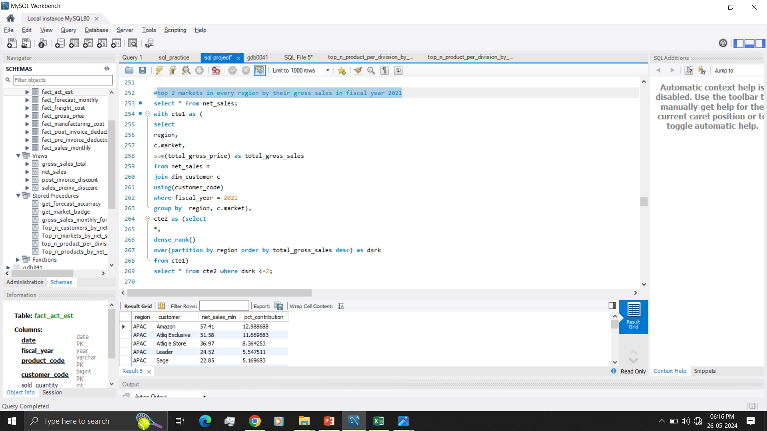
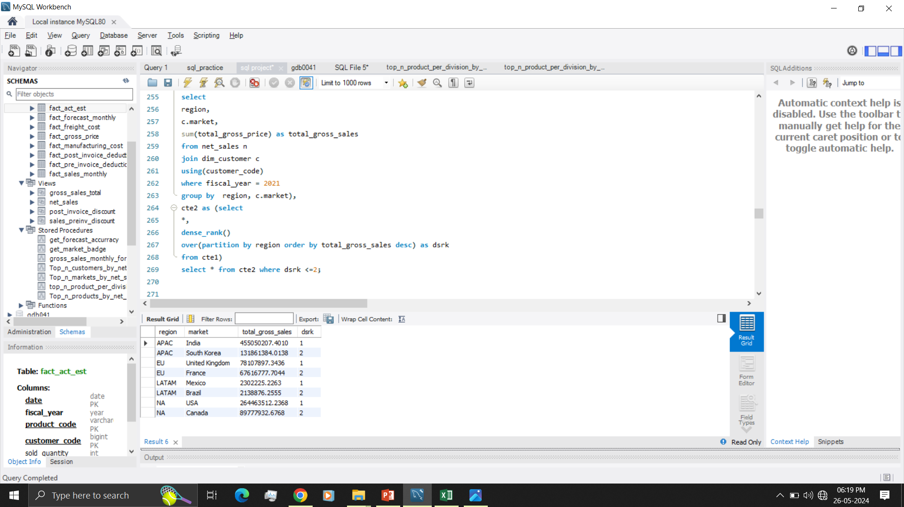
9. Top two markets in every region by their gross sales in fiscal year 2021

Slide 25
10. Forecast accuracy for all customers for a given fiscal year
Details: aggregate forecast accuracy report for all the customers for a given fiscal year to track accuracy of forecast. Report should have following columns
-- customer code
-- customer name
-- market
-- total sold quantity
-- total forecast quantity
-- net error
-- absolute error
-- forecast accuracy

Slide 26
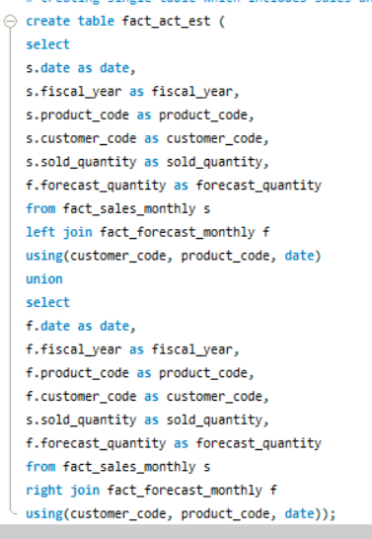
Created single table which includes sales and forecast quantity to make query simple and created triggers to automatically update new records from fact_sales_monthly and fact_forecat_monthly to fact_act_est

Slide 27
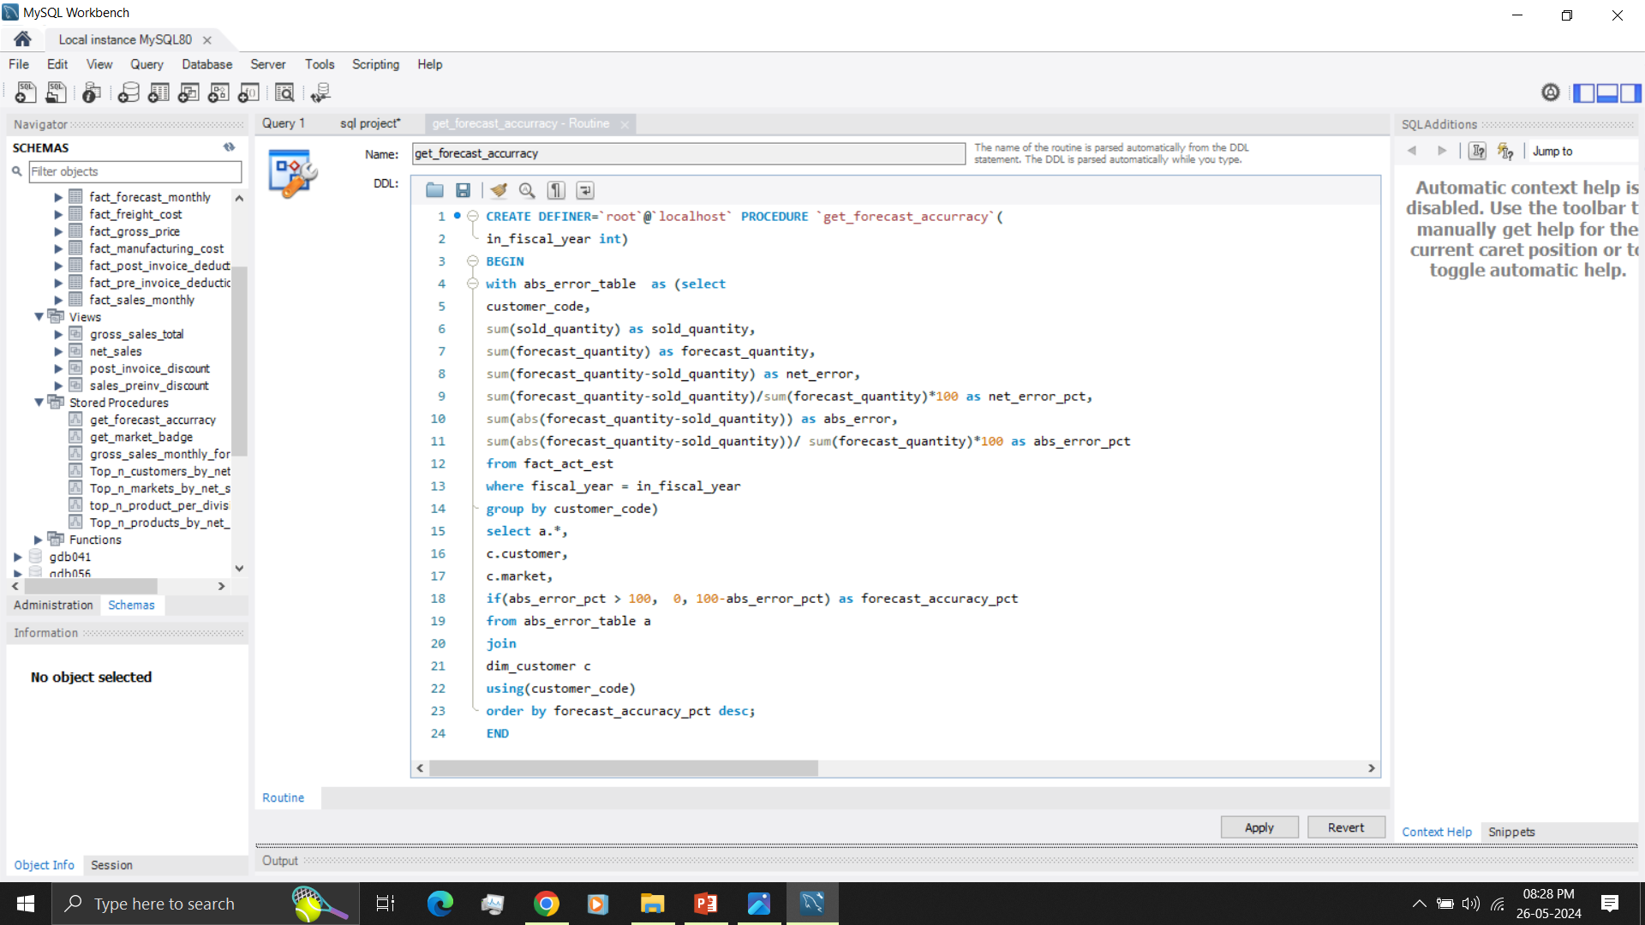
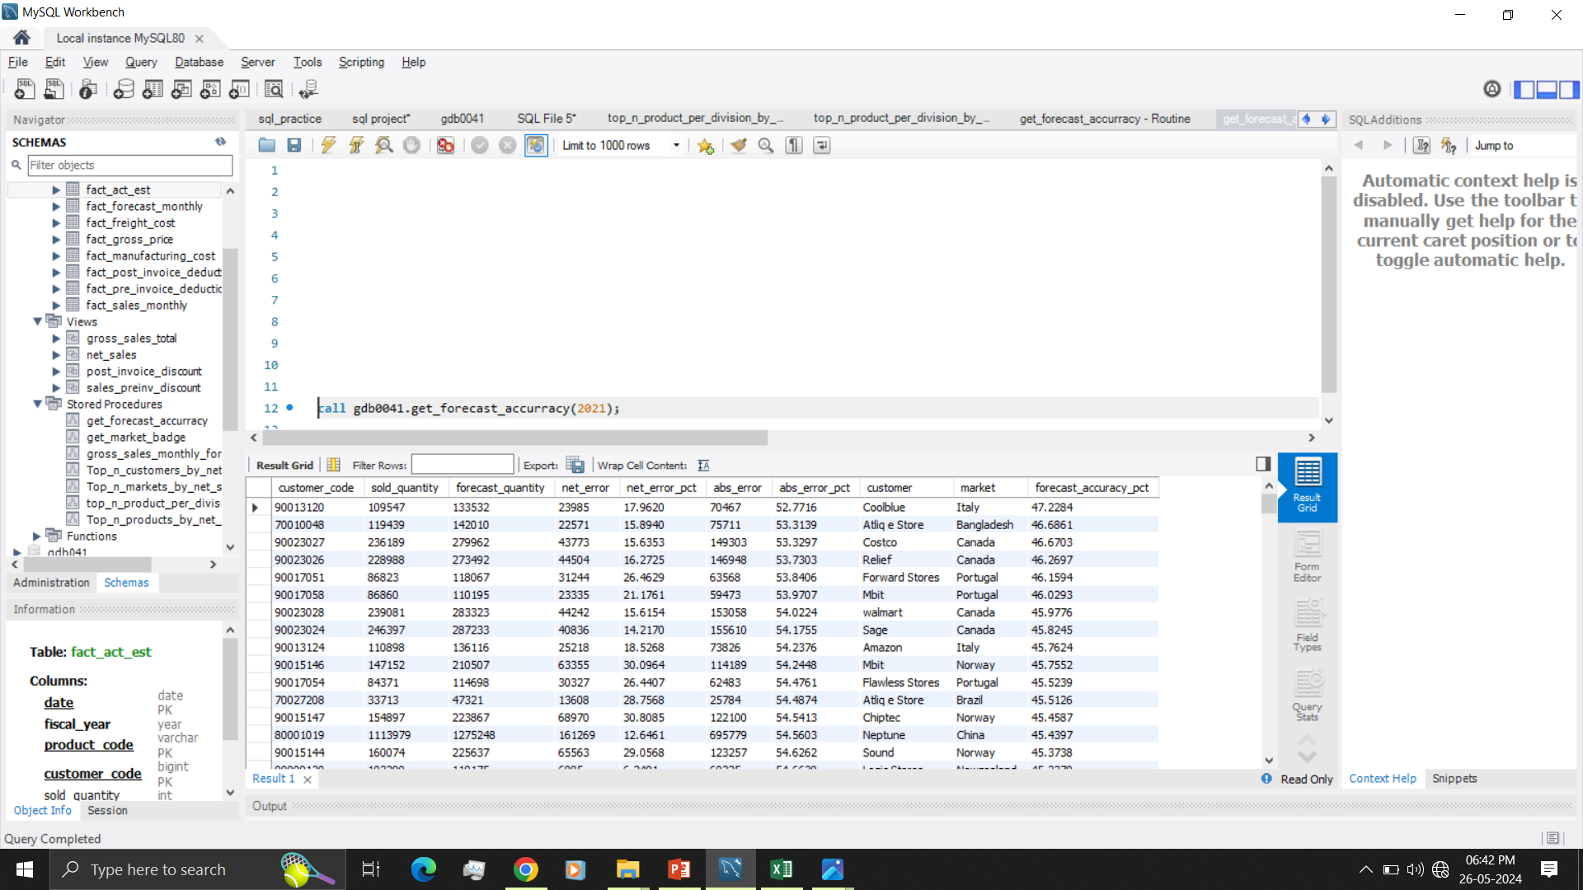
Forecast accuracy for given year

Slide 28
11. Which customers forecast_accuracy has dropped from 2020 to 2021
with columns
-- customer code
-- customer name
-- market
-- forecast_accuracy 2020
-- forecast_accuracy 2021

Slide 29
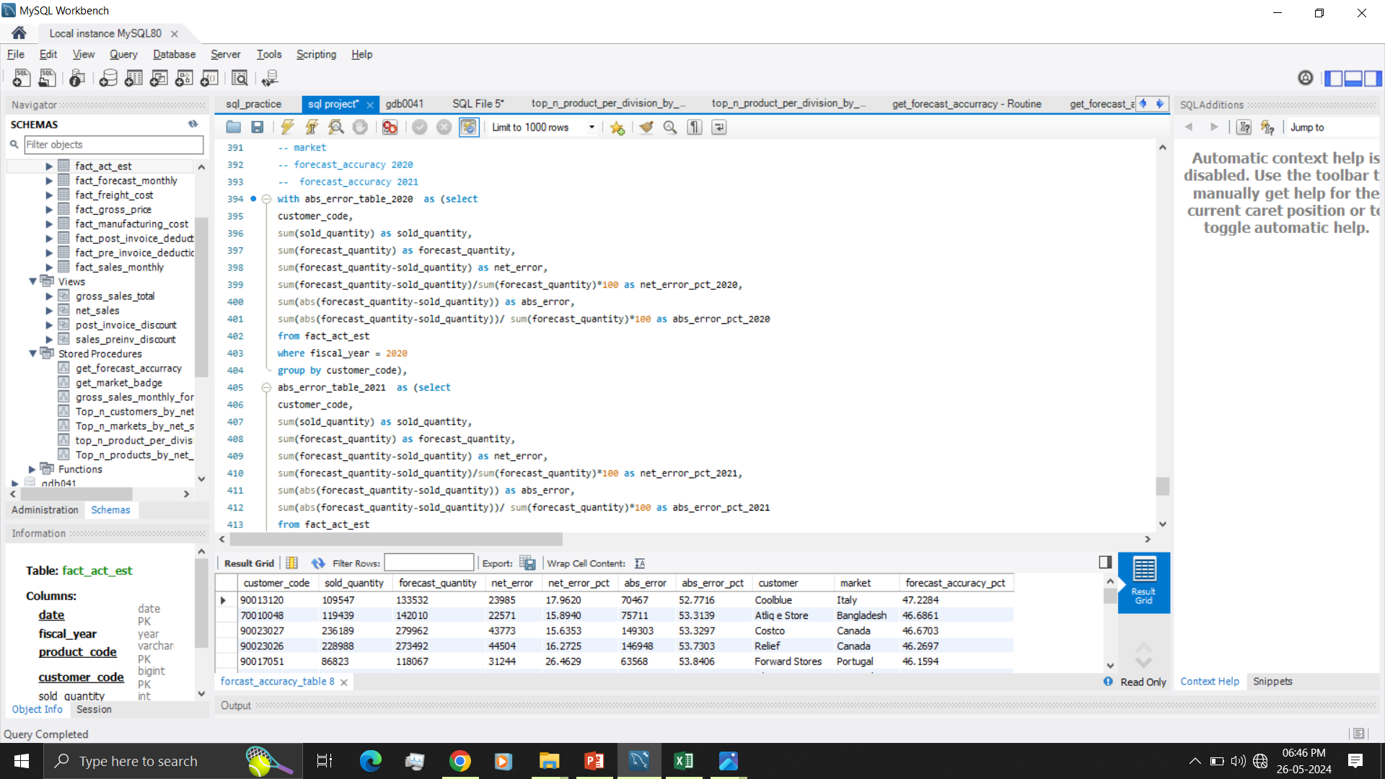
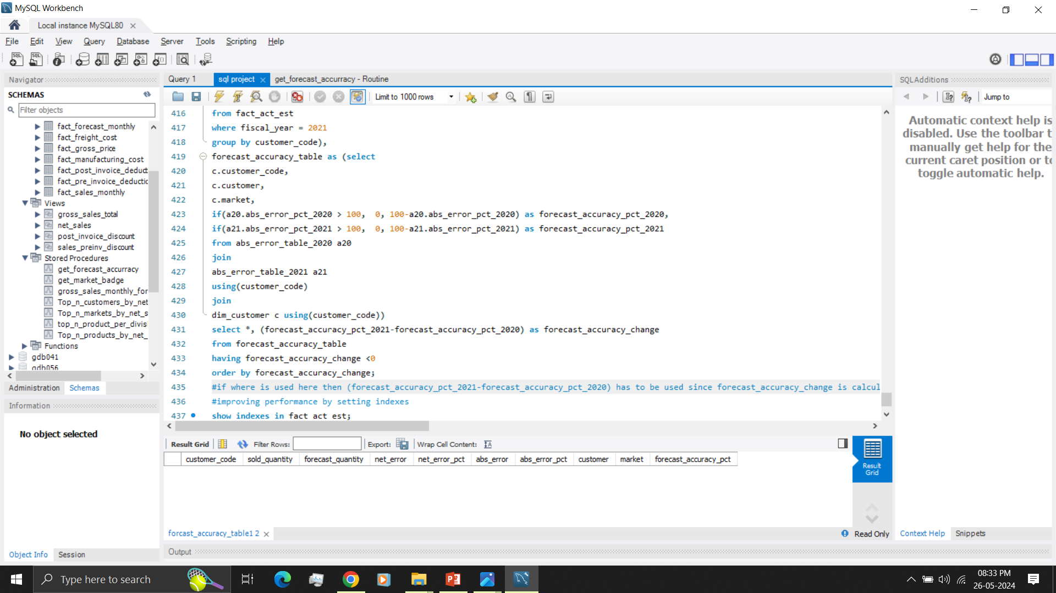
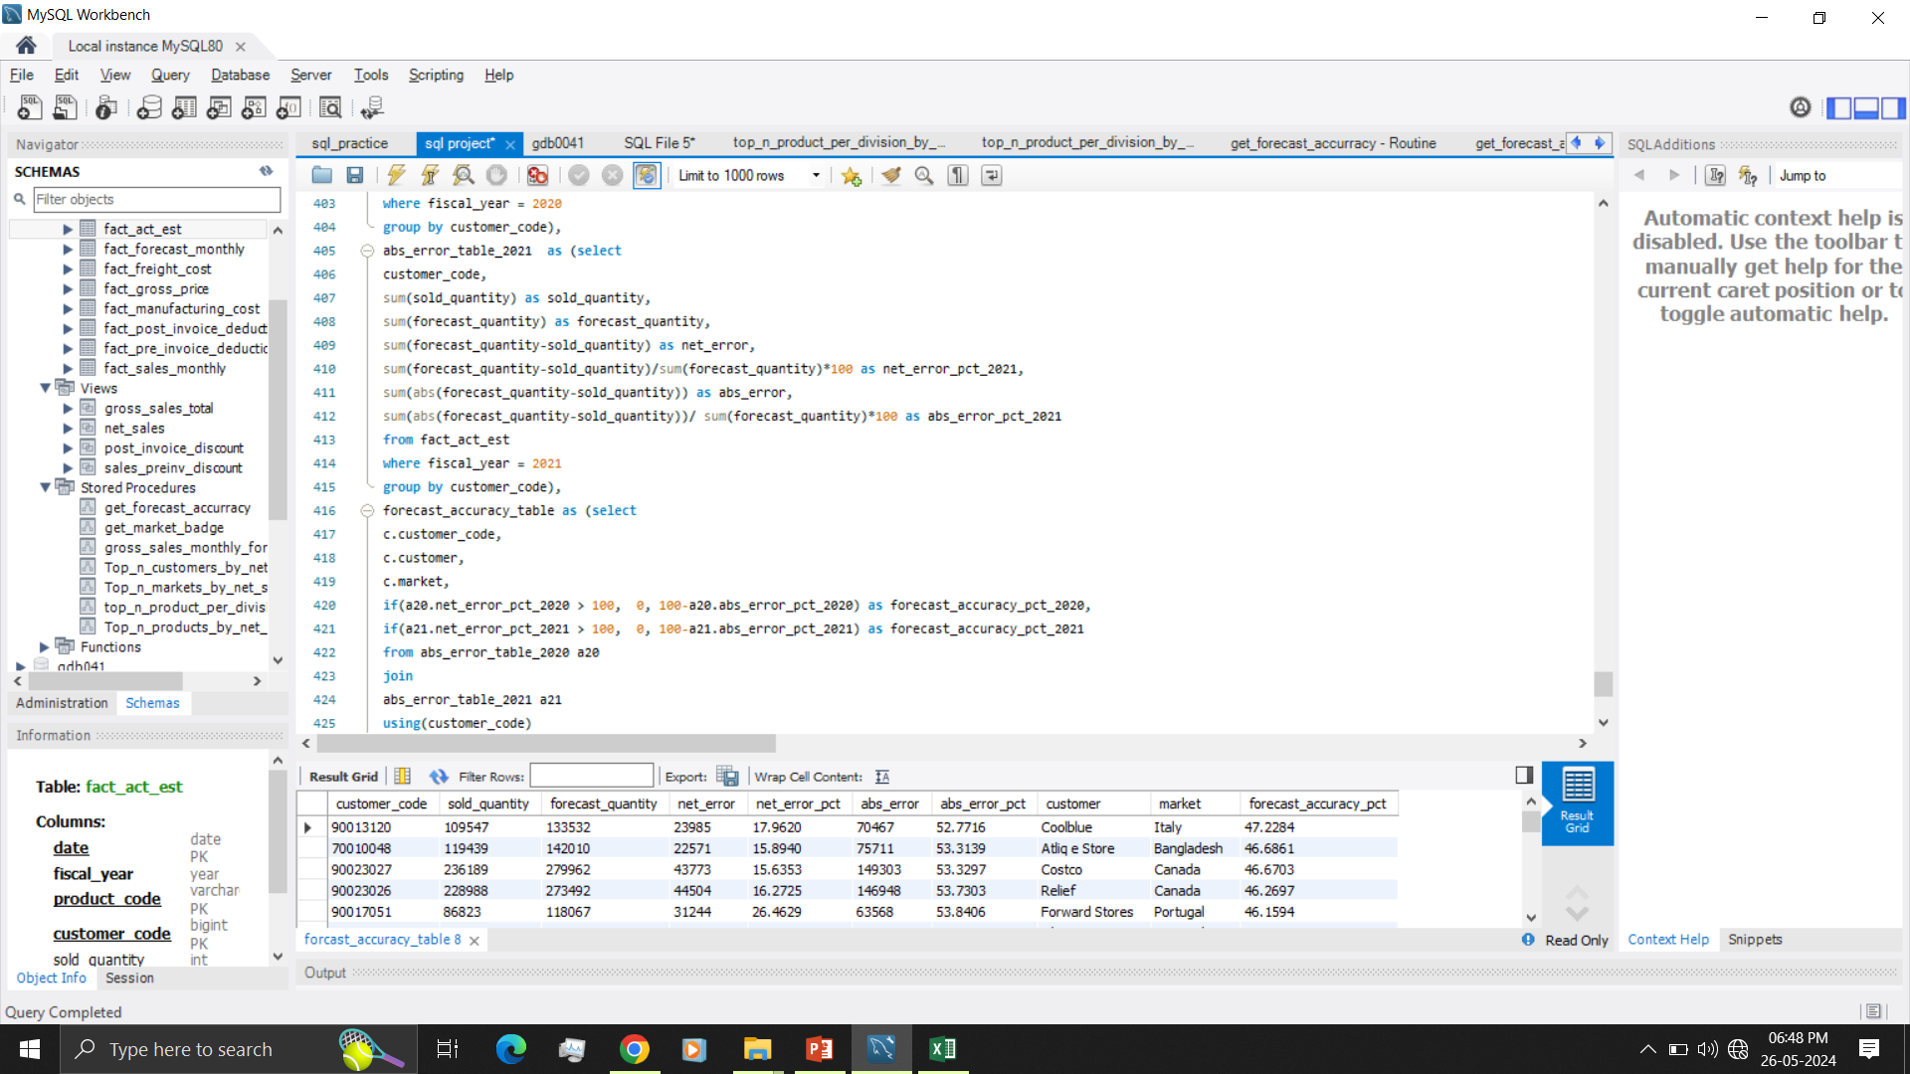
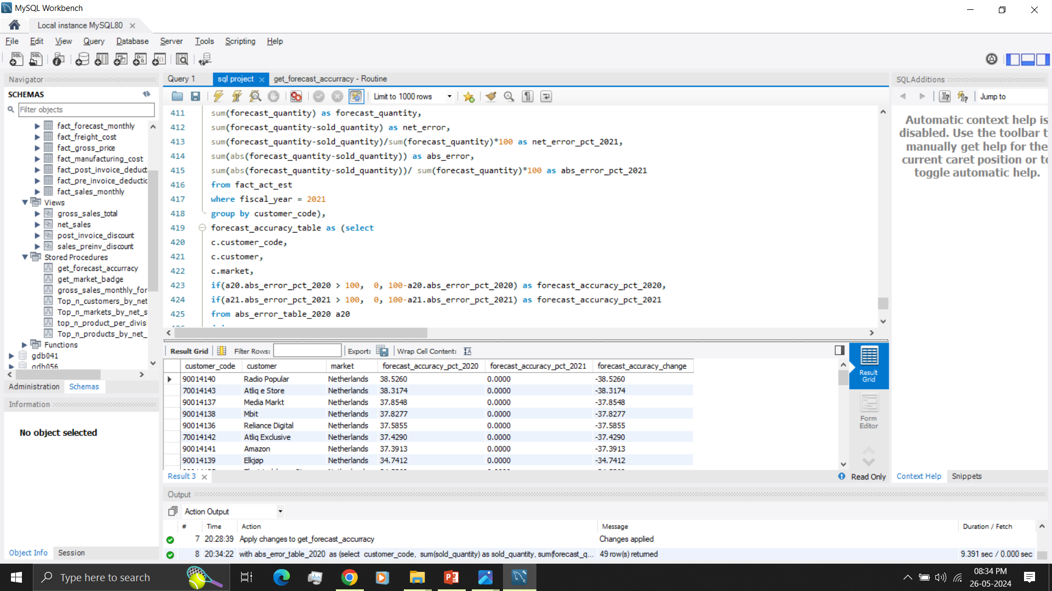

Slide 30
Performance optimization
To analyse performance explain analyze, analyze were used
To optimize performance additional tables, columns indexes were created.

Slide 31
Insights
Netherlands forecast accuracy has dropped drastically in 2021
Amazon has highest contribution percentage by net sales in all regions
India is the biggest market with 210 million net sales
Sales has drastically increased from 6.4 million in 2018 to 121.1 million in 2021 for Croma India

Slide 32
Thanking You … : )

